Slide 1
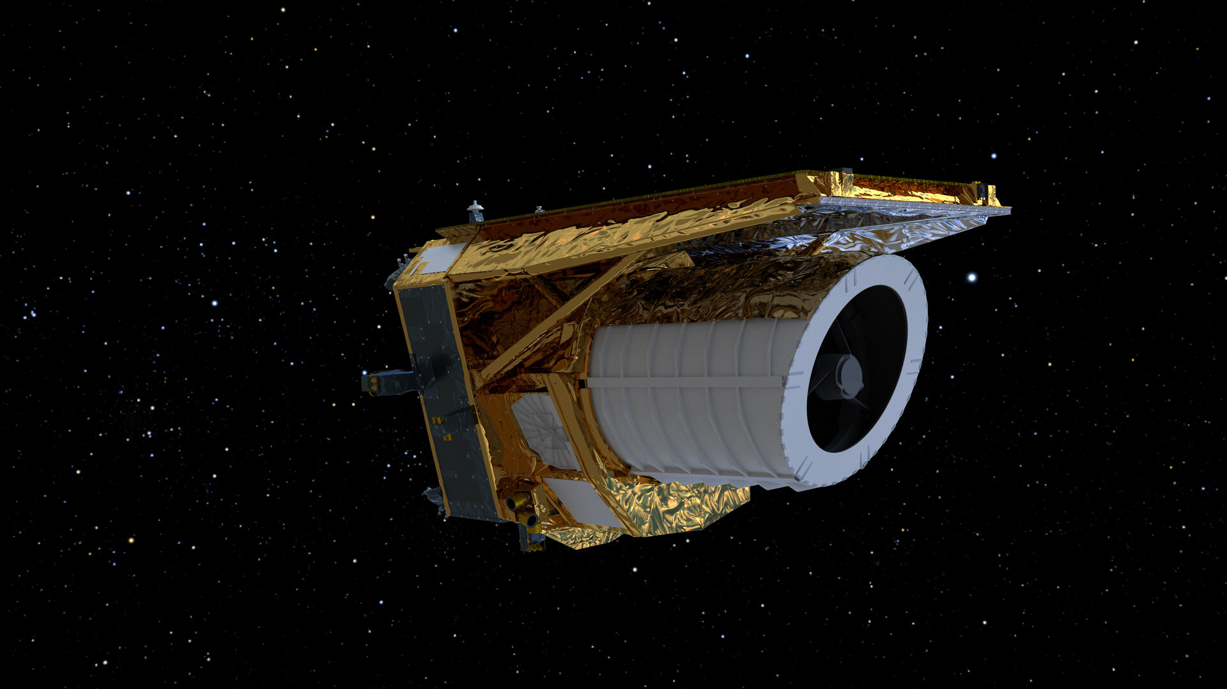
Measuring Galaxy Morphologies
With
Euclid!

Slide 2
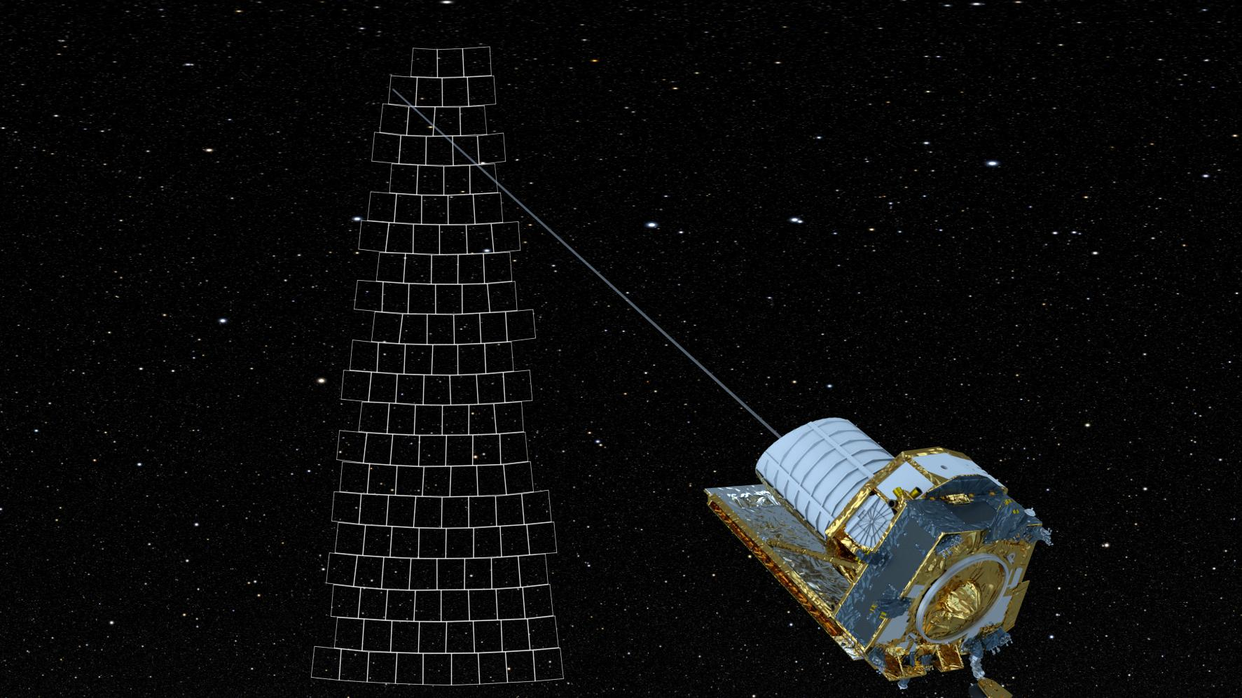
Euclid Space telescope
Made by
European
Space Agency
Survey Telescope:
Will image >1 Billion
galaxies
Visible
AND
Near Infrared
(VIS & NIR)

Slide 3
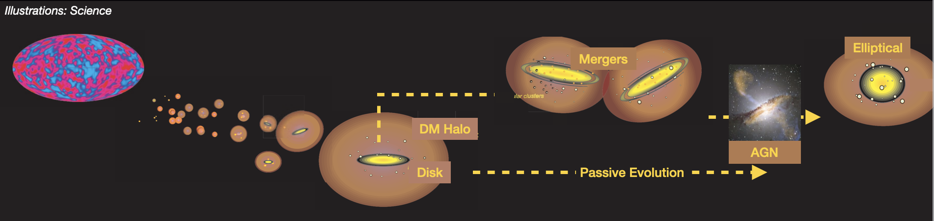
The Life of Galaxies!

Slide 4
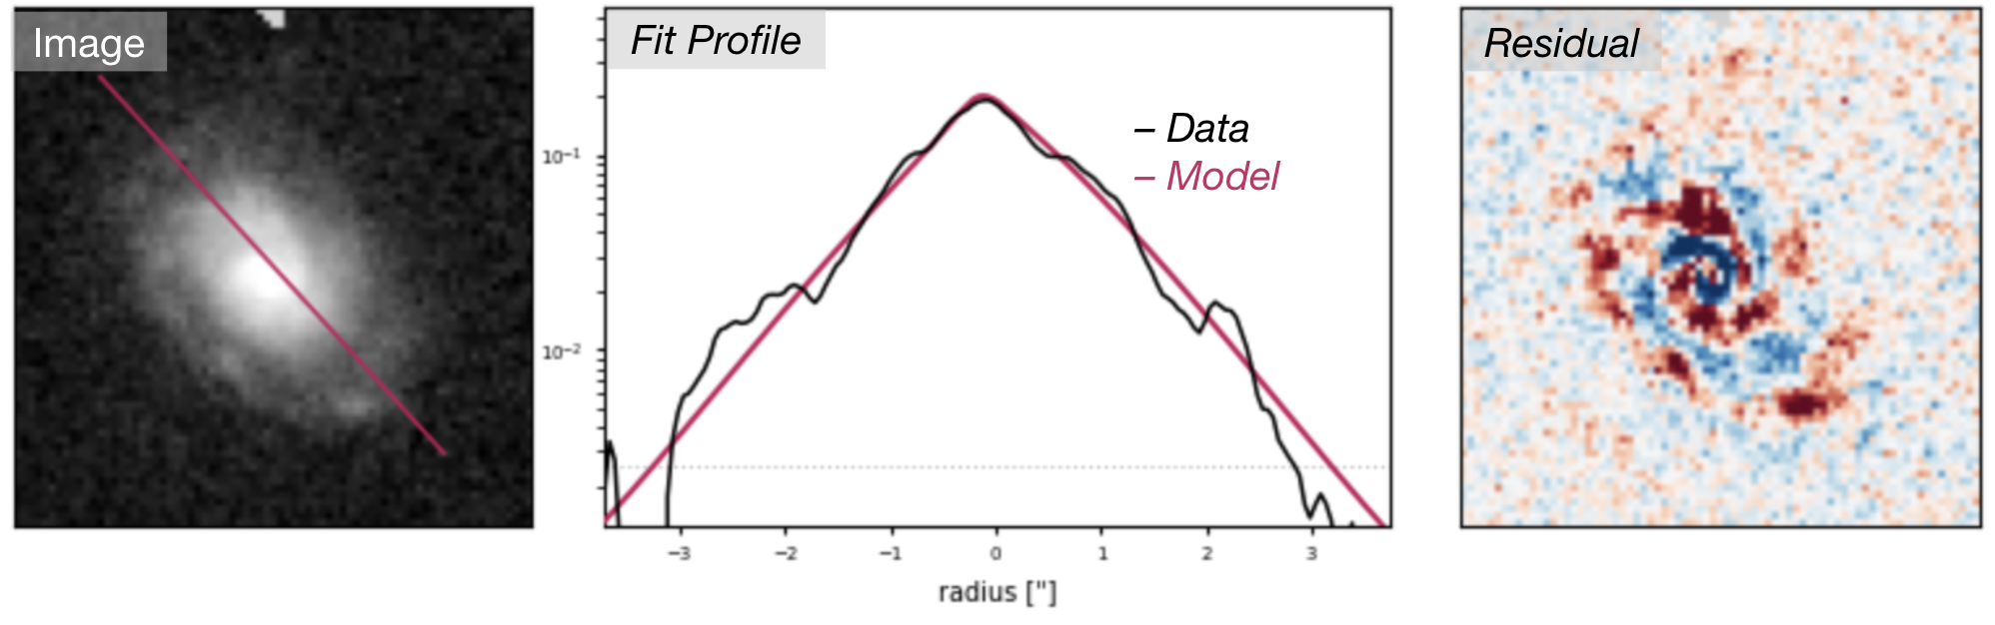
Light Profile Fitting: Measuring the Shape
‘Fitting’ = finding a function which describes your data
Real Euclid Image in Visible Light
We use fit a “Sersic profile” to it
This profile tells us if it is a Disk Galaxy Or a Ellipsoidal Galaxy

Slide 5
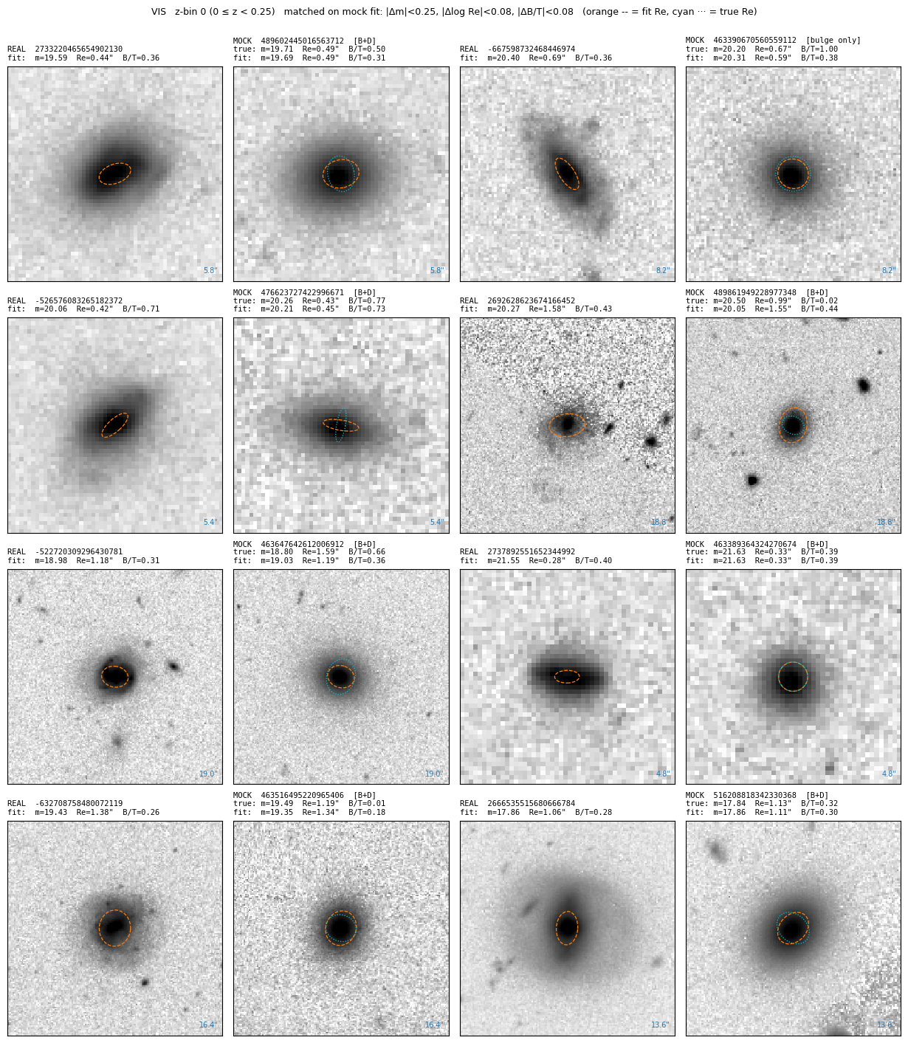
The Project:
We will be fitting Real and Simulated Euclid galaxies using a python package called PySersic.
Using the simulated galaxies to benchmark PySersic’s fitting performance, then apply it to real galaxies!
Fitting
Likelihood Optimization
Markov Chain Monte Carlo
Bayesian Analysis

Slide 6
The project:
Fit these galaxy images with sersic profiles using PySersic.
Compare the fitted morphologies (disk vs. bulge galaxy) with the true values.
Does this depend on things like: Source Brightness? Redshift? Wavelength?
Pysersic also supports ‘multiband fitting’ so maybe we try to see how much better the fits are when using all 4 bands?

Slide 7
Project SubGoals
Mocks
  Single Band
    How does the fit performance change with source magnitude?
    How does the fit performance change with redshift?
    How does the fit performance change with ?
  Multiband
    Compare single band fitting to multiband fitting
Real Galaxies
  Multiband fitting vs. Single Band Fitting
Stay at z=0.
Compare Single Band vs. Multiband fitting on Mock Galaxies
  Compare single band vs. multiband performance.
  Look at degenerate galaxies in posterior space
  Look at disk-collapsed galaxies in posterior space

